Slide 1
Introduction to Azure Deployment Environments
Will Velida
Lead Platform Engineer @ Mantel Group
@willvelida
July 2024

Slide 2

$ whoami?
Lead Platform Engineer at Mantel Group.
.NET and Azure Developer with experience in banking, agriculture, health and insurance industries.
Former MSFTer and Microsoft MVP.
Former average rugby player.

Slide 3
Agenda
Current issues with provisioning app infrastructure
What are Azure Deployment Environments?
Key Concepts of Azure Deployment Environments
Creating our ADE resources
Q&A

Slide 4
Early testing is critical for future-ready apps
The high cost of app failures
Time spent debugging
Shifting testing left
Software errors cost US companies upwards of $2.08 trillion annually¹
38% of developers spend a quarter of their time fixing software bugs²
Developers can find and fix bugs early in development lifecycle and increase app quality
1. CISC, The cost of poor software quality in the US: A 2022 report; 2. Rollbar, 2021 State of Software Code Report

Slide 5
Current processes to get app infrastructure are complex…
Start here
Find out how to get access to a new test environment
Raise a ticket to request a new environment
Provide details about the application
Wait for admins to create and configure infrastructure
Go back and forth to align on requirements
Clarify requirements with platform engineers
Validate whether the app code works on the test environment
Wait for admins to update or fix the infra configuration
Finally get access to the working infrastructure
Repeat the process for a new test environment

Slide 6
Deliver positive experiences and accelerate developer productivity
A new paradigm for app infra provisioning
Empowering developers to do their best work
Built-in guardrails and enterprise trust

Slide 7





Introduction to Azure Deployment Environments
Infrastructure-as-code Template Catalog
On-Demand Environment
Sandbox Environment
Azure Mappings
Dev Infra Teams
Create templates and map projects to Azure subscriptions, identities, and permissions
Subscription
Developers
Deploy environments using templates based on current stage of development
CI/CD Pipeline Environments
Identity
Permissions
Notes:
Hey everyone, my name is Will Velida, I’m a Software Engineer and Cloud Architect and in this video, we’ll be introducing ourselves to Azure Deployment Environments.
Azure Deployment Environments essentially help development teams to quickly and easily spin up app infrastructure using project-based templates that establish consistency and best practices while maximizing security. This on-demand access to secure environments accelerates the different stages of the software development lifecycle in a compliant and cost-efficient way.
A deployment environment is a collection of Azure infrastructure resources defined in a template called an environment definition. Developers can deploy infrastructure defined in the templates in subscriptions where they have access, and build their applications on the infrastructure.
Platform engineers can create and manage environment definitions. To specify which environment definitions are available to developers, platform engineers can associate environment definitions with projects, and assign permissions to developers. They can also apply Azure governance based on the type of environment, such as sandbox, testing, or production.
The following diagram shows an overview of Azure Deployment Environments capabilities. Platform engineers define infrastructure templates and configure subscriptions, identity, and permissions. Developers create environments based on the templates, and build and deploy applications on the infrastructure. Environments can support different scenarios, like on-demand environments, sandbox environments for testing, and CI/CD pipelines for continuous integration and continuous deployment.

Slide 8
When would we use this?
Platform Engineers
Developers
Provide re-usable IaC templates.
Define specific Azure Deployments.
Provide self-service experience.
Track costs and compliance.
Deploy preconfigured environments.
Spin up sandbox environments in Azure
Create and manage environments with AZ CLI, AZD CLI or developer portal
Notes:
Usage scenarios
Common scenarios for Azure Deployment Environments include:
Platform engineering scenarios
Azure Deployment Environments helps platform engineers apply the right set of policies and settings on various types of environments, control the resource configuration that developers can create, and track environments across projects. They perform the following tasks:
Provide a project-based, curated set of reusable IaC templates.
Define specific Azure deployment configurations per project and per environment type.
Provide a self-service experience without giving control over subscriptions.
Track costs and ensure compliance with enterprise governance policies.
Developer scenarios
Developers can create environments whenever they need them, and develop their applications on the infrastructure. They can use Azure Deployment Environments to do the following tasks:
Deploy a preconfigured environment for any stage of the development cycle.
Spin up a sandbox environment to explore Azure.
Create and manage environments through the developer portal, with the Azure CLI or with the Azure Developer CLI.

Slide 9
Benefits
Standardization and collaboration
Compliance and governance
Project-based configurations
Self-service capabilities
Integration with existing tools
Notes:
Azure Deployment Environments provides the following benefits to creating, configuring, and managing environments in the cloud:
Standardization and collaboration: Capture and share IaC templates in source control within your team or organization, to easily create on-demand environments. Promote collaboration through inner-sourcing of templates from source control repositories.
Compliance and governance: Platform engineering teams can curate environment definitions to enforce enterprise security policies and map projects to Azure subscriptions, identities, and permissions by environment types.
Project-based configurations: Organize environment definitions by the type of application that development teams are working on, rather than using an unorganized list of templates or a traditional IaC setup.
Worry-free self-service: Enable your development teams to quickly and easily create app infrastructure (PaaS, serverless, and more) resources by using a set of preconfigured templates. You can also track costs on these resources to stay within your budget.
Integration with your existing toolchain: Use APIs to provision environments directly from your preferred CI tool, integrated development environment (IDE), or automated release pipeline. You can also use the comprehensive command-line tool.

Slide 10
Key Concepts of Azure Deployment Environments

Slide 11
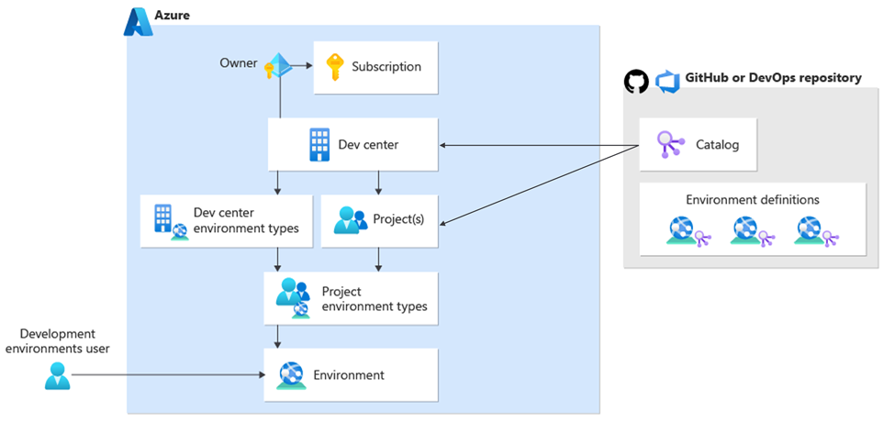
Key Components of Azure Deployment Environments

Slide 12
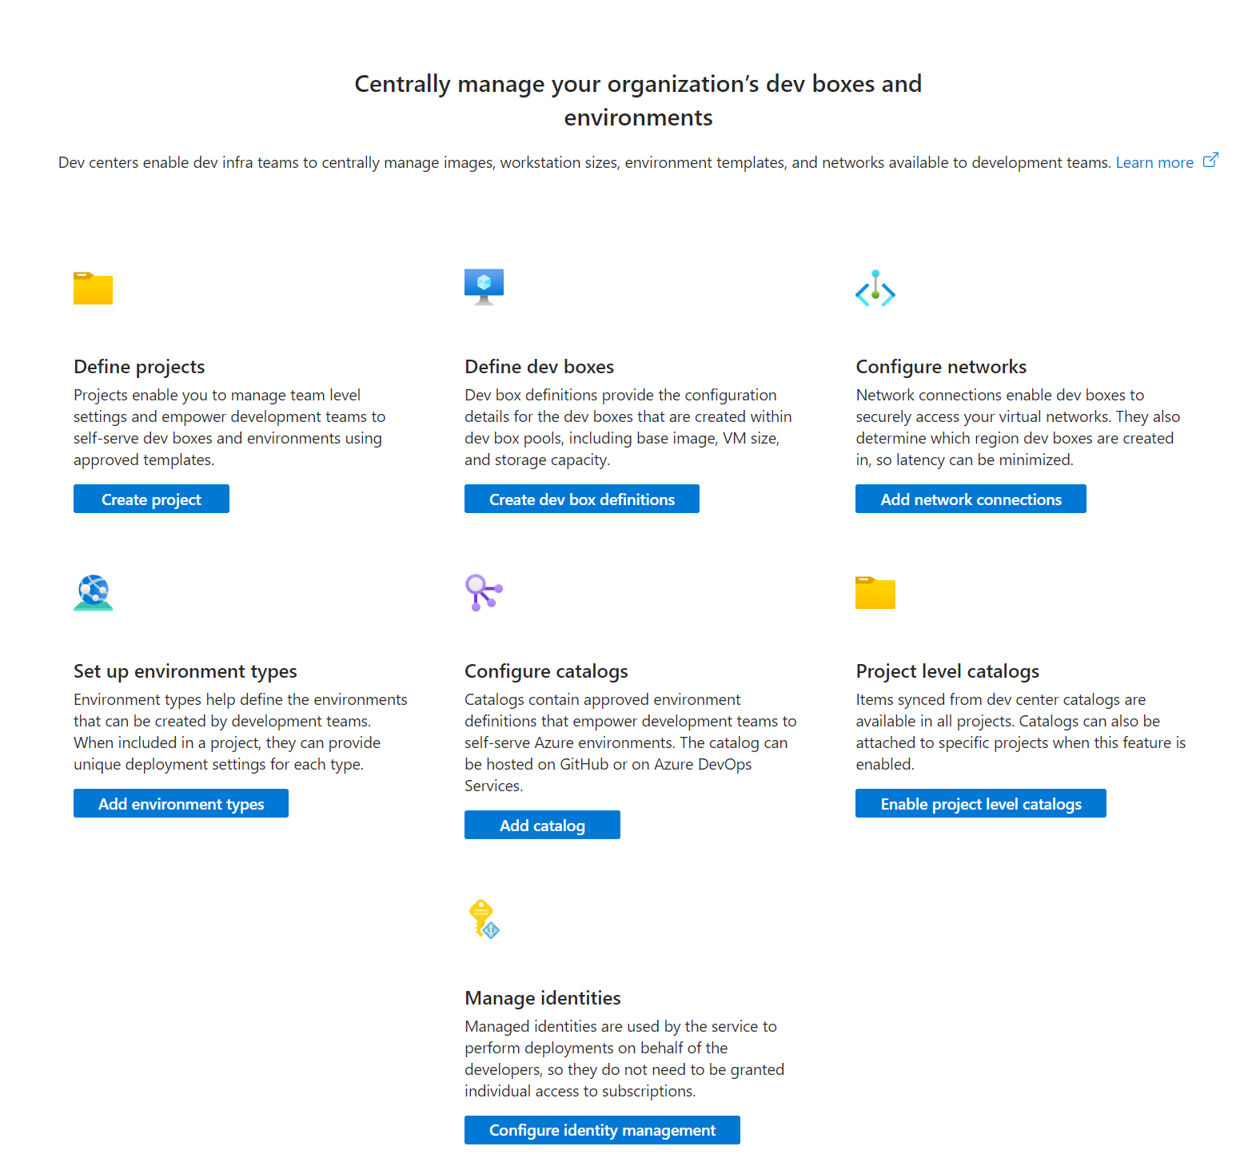
Dev Centers
A collection of Projects that require similar settings. These enable Platform Engineers to:
Use Catalogs to manage IaC templates available to projects.
Use Environment types to configure types of environments that can be created

Slide 13
Projects
This represents a team or business function within your organization.
Each project can only be associated with one Dev Center
Platform Engineers configure environments for a project by specifying which environment types are needed for a developer team.

Slide 14
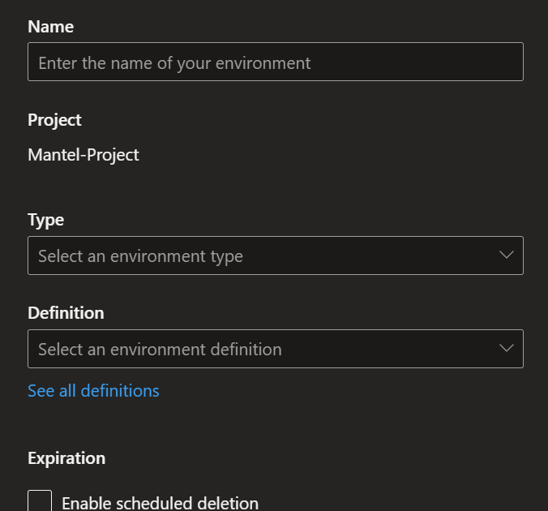
Environments
A collection of Azure resources on which your application is deployed.
This might be a Container App that uses Cosmos DB as a Database, with Key Vault for secrets.
Can consist of both PaaS and IaaS services.

Slide 15

Identities
In Azure Deployment Environments, you use Managed Identities to provide elevation-of-privilege.
This is better than giving those privileges to individual developers on your team.
The Dev Center or Project will have a managed identity that will be granted access to connect to catalogs and perform deployments.
Azure Deployment Environments support three built-in roles:
Dev Center Project Admin: Creates environments and manages the environment types for a project
Deployment Environments User: Creates environments based on appropriate access
Deployment Environments Reader: Reads environments that other users created.

Slide 16
Dev Center Environment Types and Project Environment Types
Dev Center Environment Types
Project Environment Types
We can define different environment types that development teams can create (DEV, UAT, PROD)
You can map the same environments that you use in your organization, and then configure the settings for various environment types based on what your development team needs.
These are a subset of environment types that you configure for the Dev Center.
This helps us preconfigure the types of environment that specific development teams can create.
You configure the target subscription in which Azure resources are created per project and environment type.

Slide 17
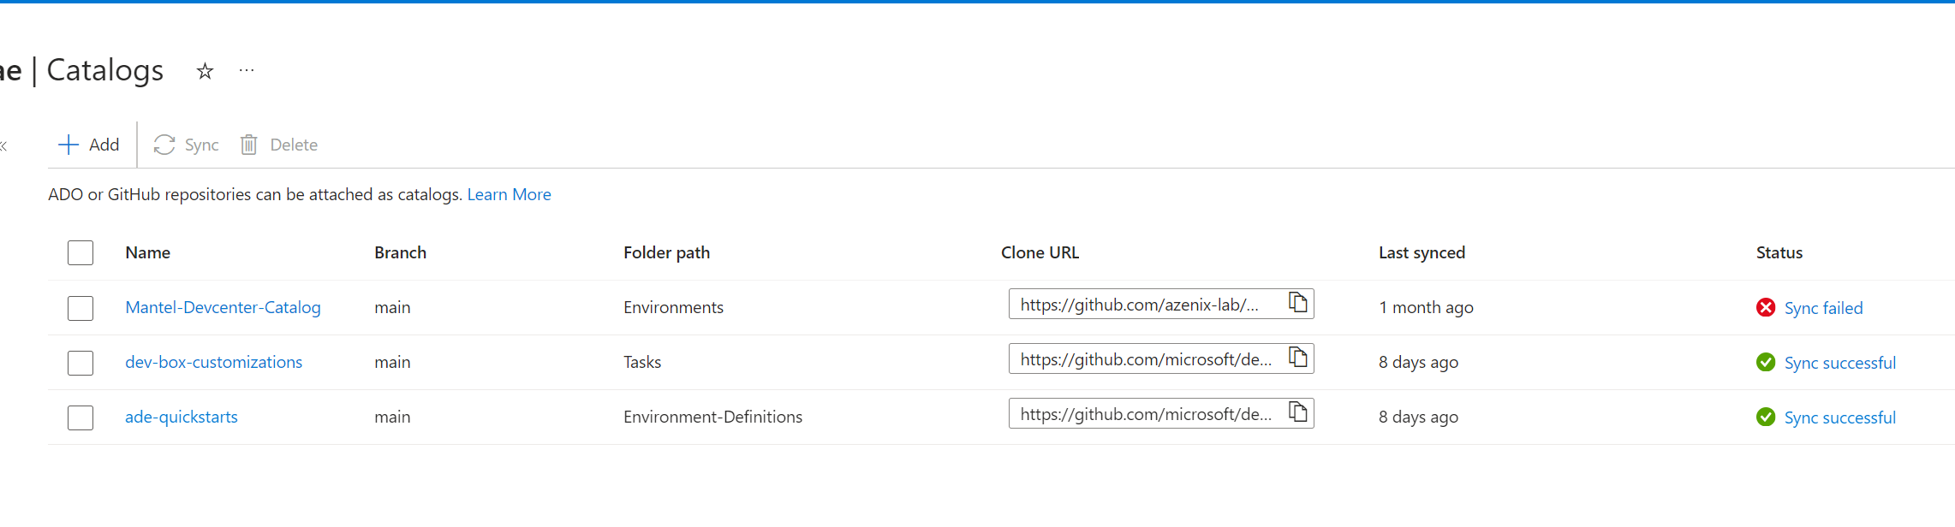
Catalogs
Curated set of IaC templates for your development teams to create environments.
Can create project-specific catalogs.
Attach catalogs from Azure DevOps and GitHub repositories.

Slide 18
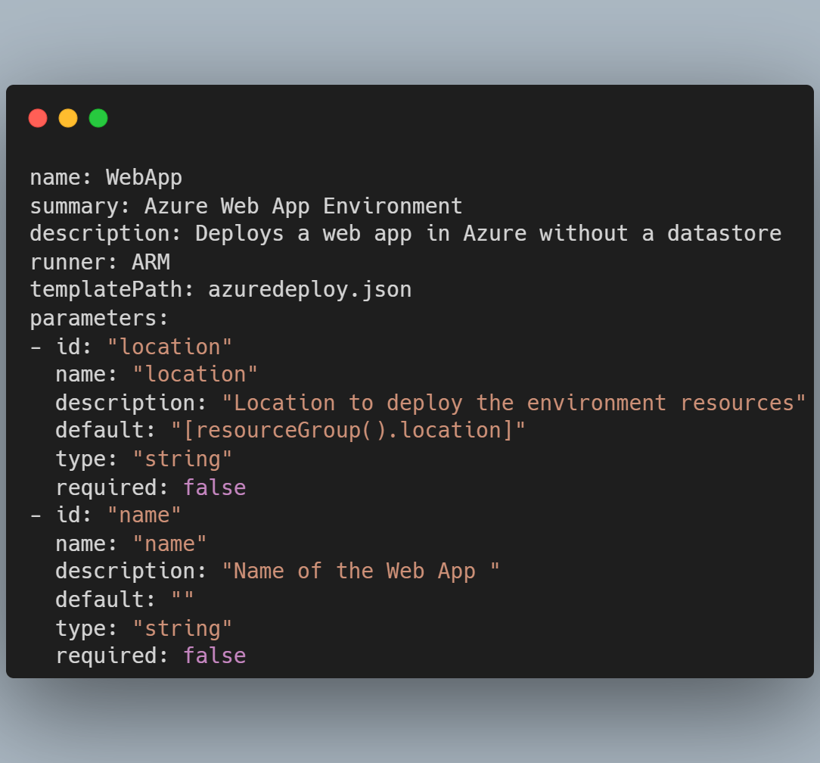
Environment Definition
Combination of IaC template and environment manifest files.
The template defines the environment.
The environment file provides metadata about the template.
Your dev teams use these to create environments in Azure.

Slide 19
Demo: Working with Azure Deployment Environments

Slide 20
Empowering dev teams with guardrails for security, governance, and cost management
Start right
Stay right
Self-service with guardrails
Everything as code
Governance and security
Self-service environments
Cost and fleet management
Developer self-service foundation
Automation

Slide 21





Thanks for listening!
willvelida.com
github.com/willvelida
youtube.com/@willvelida
linkedin.com/in/willvelida
twitter.com/willvelida

